Slide 1
Accelerator to connect
IBM Business Automation Workflow
with
IBM Process Mining
Patrick Megard - patrick.megard@fr.ibm.com

Slide 2
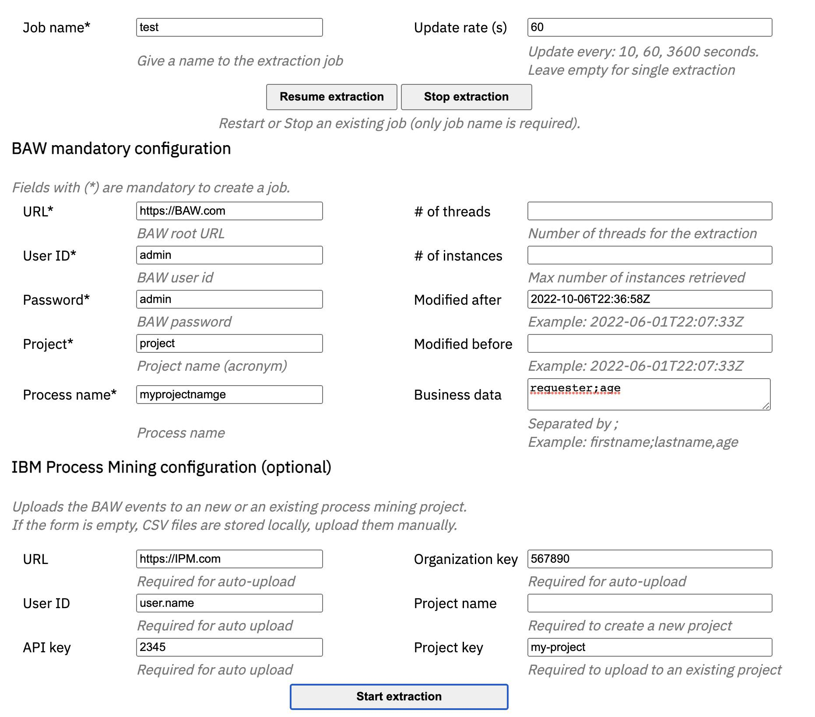
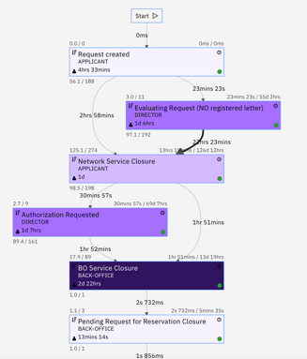
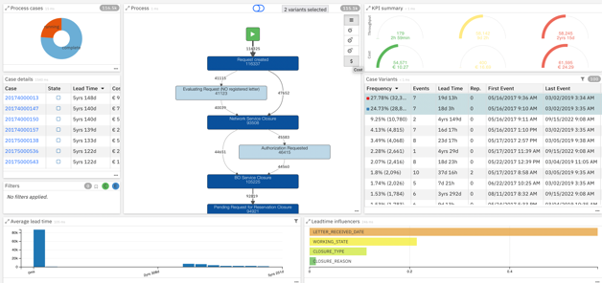
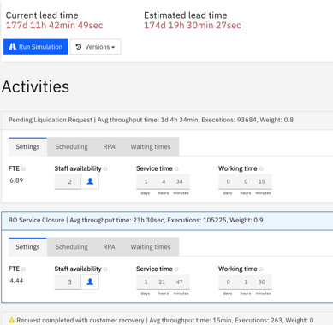
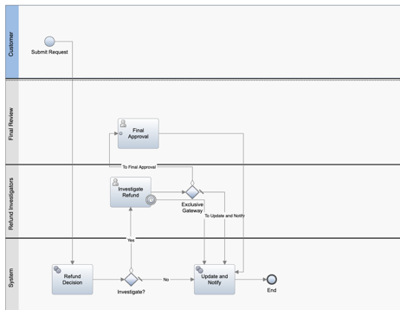
BAW Accelerator for IBM Process Mining enables:
Few clicks to connect BAW and IPM with REST APIs
Analyze process variants, durations, deviations, costs, bottlenecks
Create and share business dashboards
Simulate improvements and get ROI
Monitor business KPIs
Trigger actions
Improve processes
BAW Accelerator 4 IPM
IBM Business Automation Workflow
IBM Process Mining

Slide 3
Historical extraction
Manage the performance and the impact on BAW server
Extract instances/tasks for a period of time (from date1 to date2), with filtering options like created, modified, closed
Extract instances/tasks for a period of time with paging (ex 1000 instances each loop)
Extract instances with certain status (ex: Active, Completed, …)
Select instance status (completed,
Parallelism (ex thread_count = 10)
start
end
start
1000 instances
end
 | 1 thread | 10 threads
308 instances/383 tasks | 7 min 44 | 46 s

Slide 4
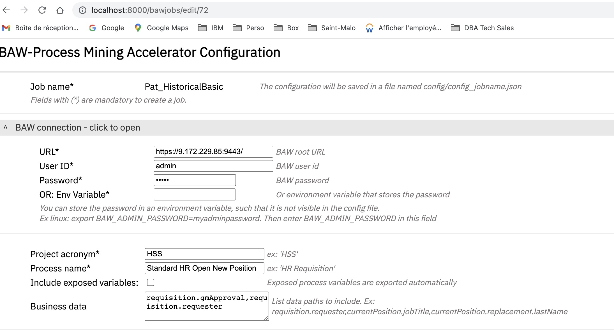
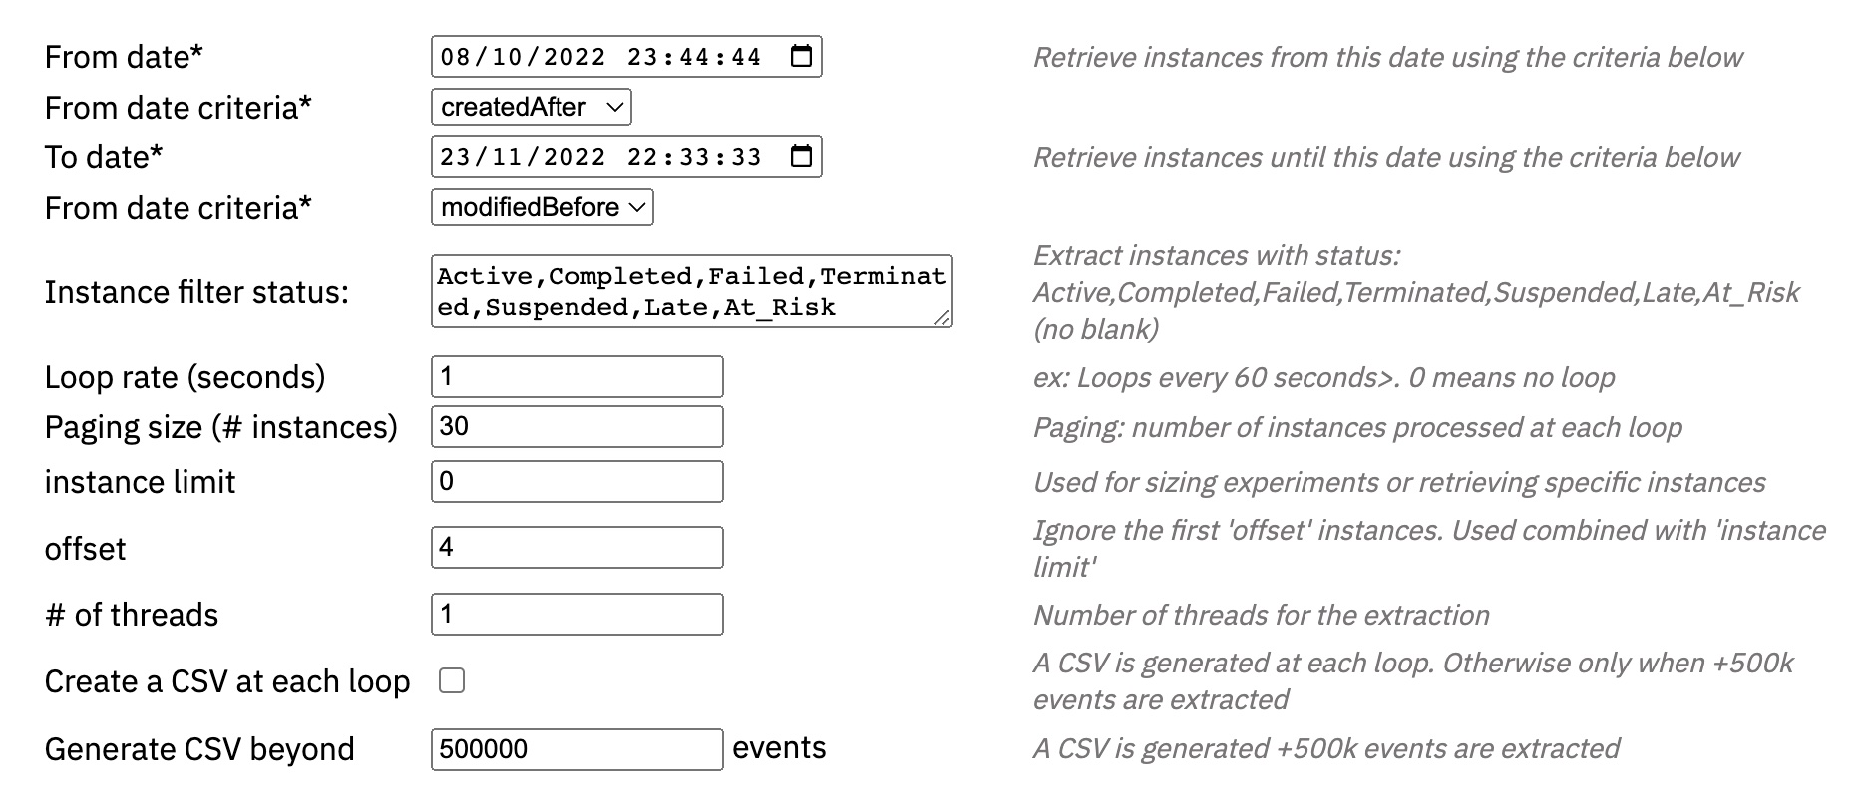
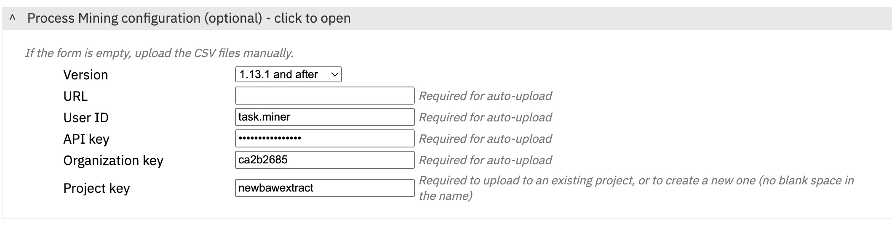
No code

Slide 5
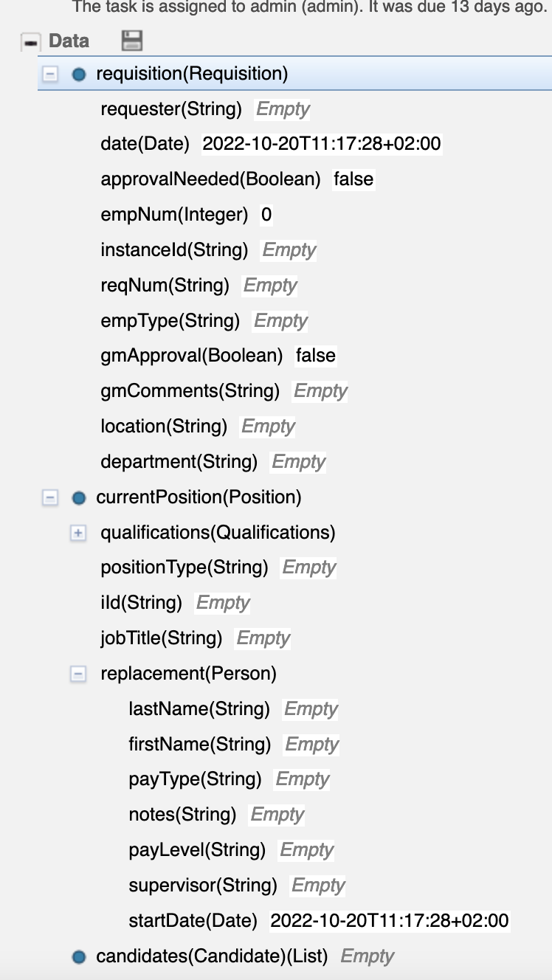
BAW business data
Tracked variables (process level)
Automatically added to each event
Typically used for PDW, BAI
Other process/task variables
Specified as a path ex: requisition.requester
Any business data can be extracted as contextual data. See: BAW/ProcessInspector/

Slide 6

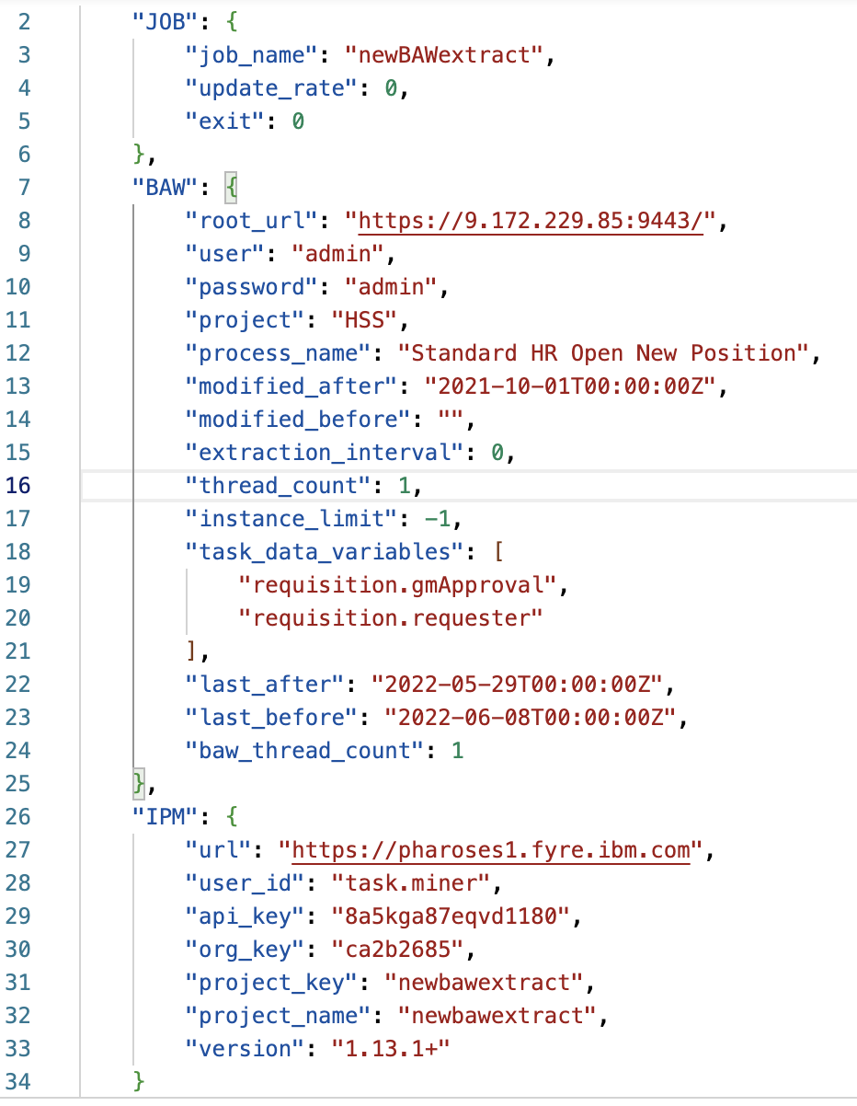
Technical details
CONFIGURE
JOBS as JSON files
EXECUTE
REST CALLS
config/confg_process1.json
“process 1”
From the Web UI
BAW REST APIs:
Retrieve instances
Retrieve task summaries
Retrieve task details
config/confg_process2.json
“process 2”
From the terminal
python3 BAW_to_IPM.py config/confg_process1.json

Slide 7
BAW REST API calls
fetch instances
<BPM Root URL>/rest/bpm/wle/v1/processes/search?modifiedAfter=2021-10-01T00:00:00Z&Standard HR Open New Position&projectFilter=HSS&limit=1
For each BPD instance, fetch task summaries
<BPM Root URL>/rest/bpm/wle/v1/process/6603/taskSummary/
For each task, fetch task data
<BPM Root URL>/rest/bpm/wle/v1/task/7753?parts=data

Slide 8
Demo

Slide 9

Spanish Real Estate - Ticketing
Case study: Ticketing
Process mining was used as a dashboarding capability to increase visibility on the ticketing process automated with IBM Business Automation Workflow.
Challenges:
Improve internal efficiency and ticket resolution time
Increase visibility on the automated process
Results:
1d
Potential improvement in process leadtime
20K
2 weeks
55%
Process lead time reduction resolving tickets re-classification
Instances analyzed
Analysis

Slide 10

Conclusion
Extractor available at:
https://github.com/IBM/ibm-process-mining-BAW-accelerator
Contact: patrick.megard@fr.ibm.com

